Slide 1
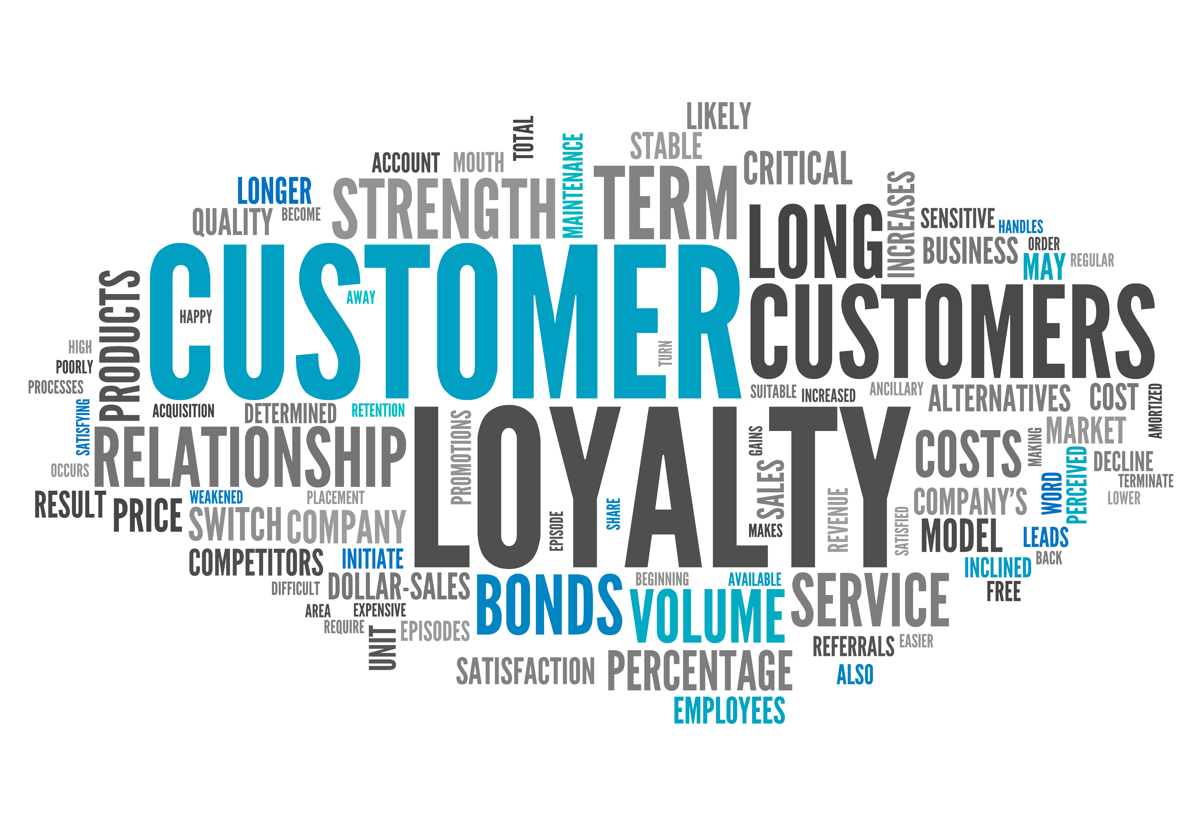
What inspires the customers to purchase?
Nitin Yadav
MSc Computing (Data Analytics)
Dublin City University

Slide 2
Presentation Outline
Subject significance
Different domains of attracting customers
Managing brands in real life
Conclusion

Slide 3

Subject Significance
Capital investment
Productivity
Customer behavior
Business growth

Slide 4
Different domains of attracting customers
Inspiring customers
Promote positivity
Make it about them
Offer testers
Encourage loyalty
Improve your brand image

Slide 5
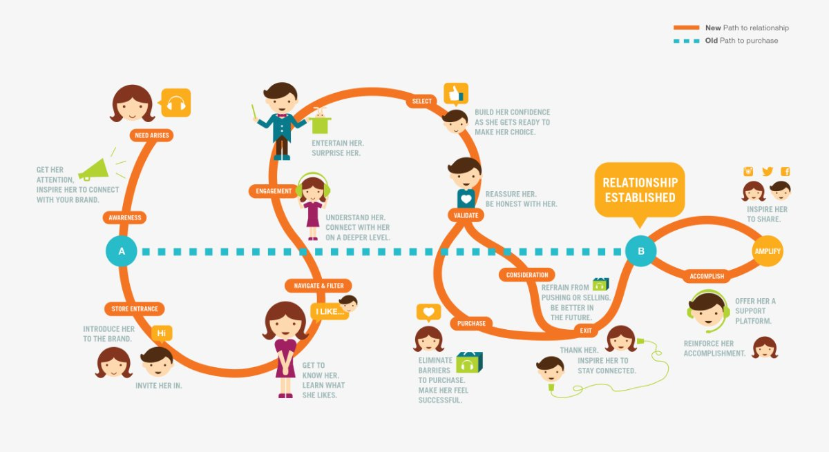
Offer
testers
Promoting
positivity
Improve your
brand image
Encourage
Loyalty
Make it
about
them

Slide 6
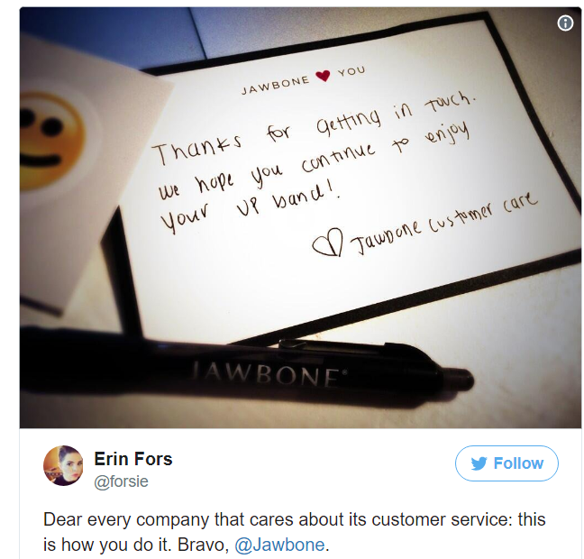



Managing brand in real life –
An example
Enhanced customer
reliability
Cheap dissemination but
imbibes a major
health risk
Enhanced nexus
with customers
Notes:
The garbage fish isn't picky with its eating habits. That makes it cheap to farm and buy, but a big health risk to consumers who don't check its country of origin.

Slide 7
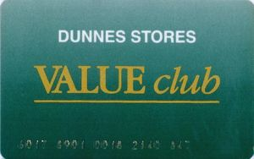
Managing brands in real life –
An example

Slide 8

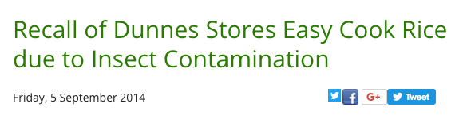
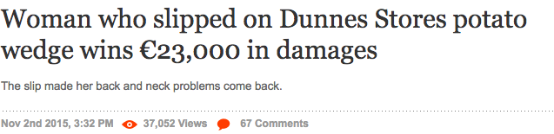
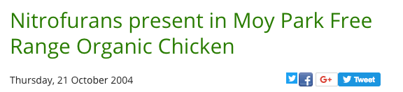
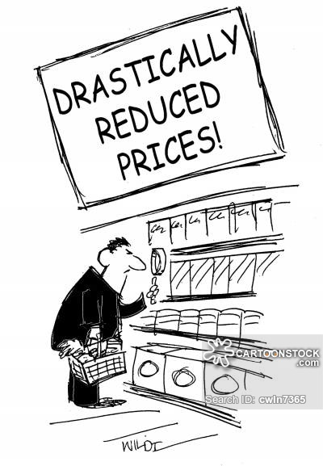


Conclusion – Learn from mistakes
Quality
assurance
Optimal daily
store management
Product Focus-
A dedicated section
for product sales
Loss Minimization-
Reduced prices of products
close to expiration date

Slide 9
Thank You

